Slide 1
UWE Bristol Time Series Analysis
- How has UWE Bristol performed over the period?
- What factors are at play in explaining UWE’s performance?
- How have UWE’s subjects fared over the period?
- What’s next for UWE Bristol in the Guardian rankings? How can we rank higher?
- How can UWE Bristol perform better in the league table in future, and how can BI support this effort?
- What factors could be harmful to UWE’s league table position? Are any changes to the league table methodology likely? How would these affect UWE?

Slide 2
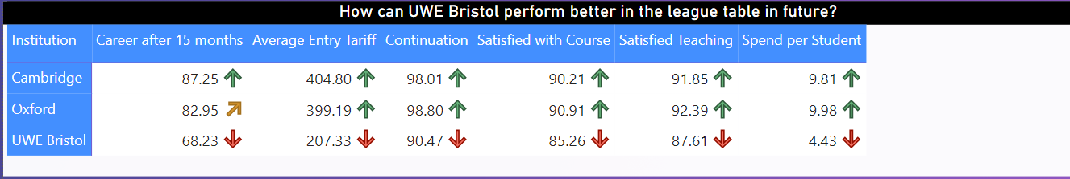
Fig: How can UWE Bristol perform better in the league table in future?

Slide 3
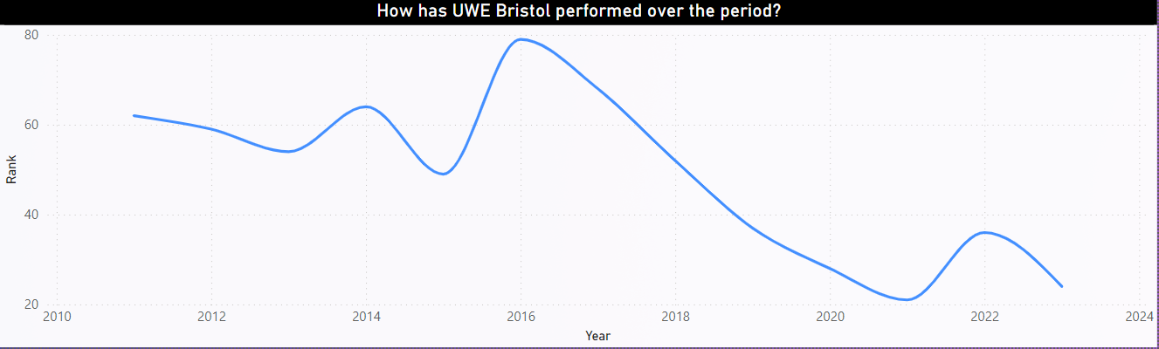
Fig: How has UWE Bristol performed over the period?

Slide 4
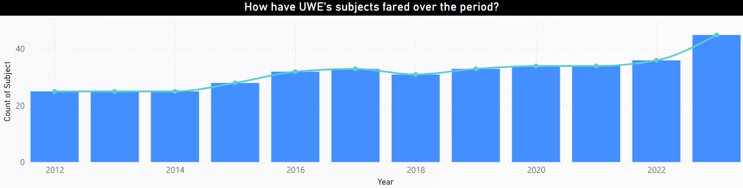
Fig: How have UWE’s subject fared over the period?

Slide 5
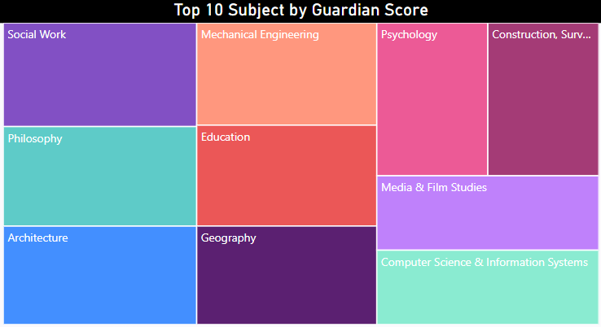
Fig: Top 10 Subject by Guardian Score

Slide 6
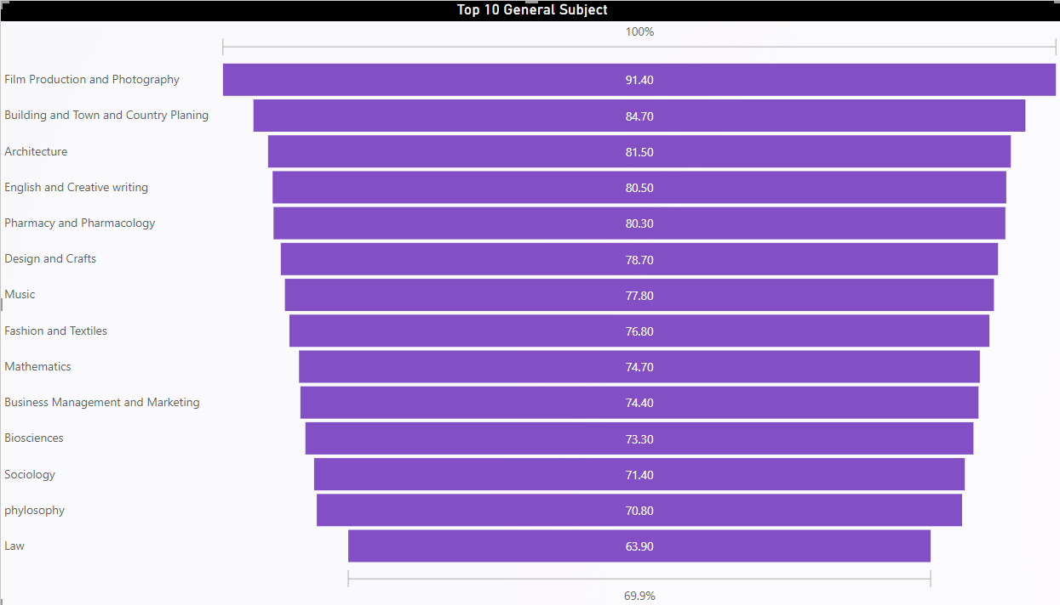
Fig: Top 10 general Subject

Slide 7
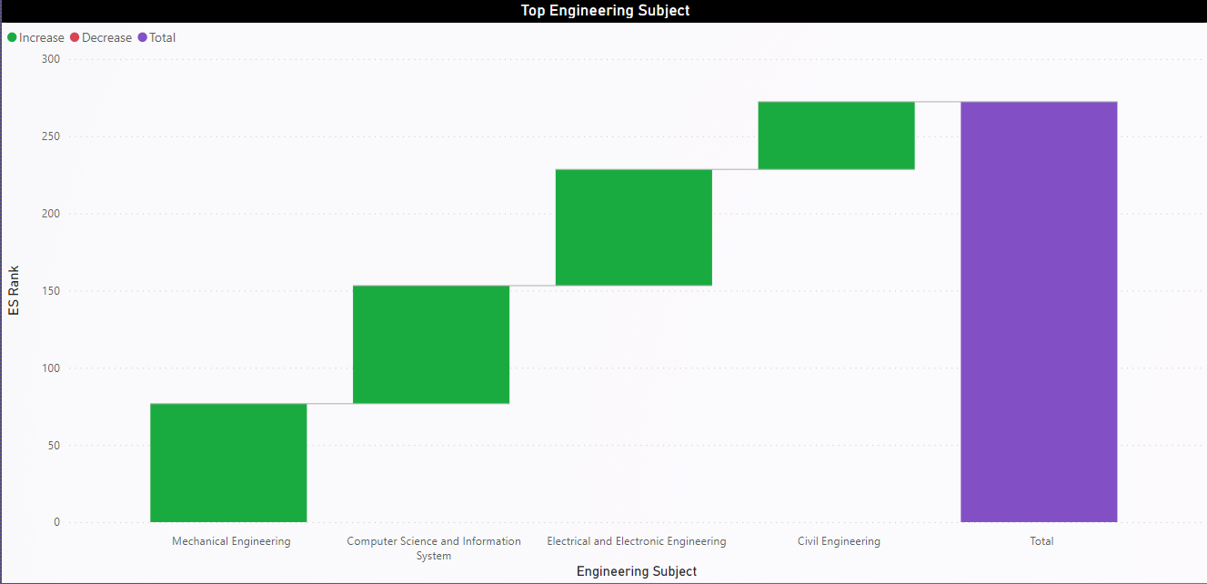
Fig: Top 10 Engineering Subject

Slide 8
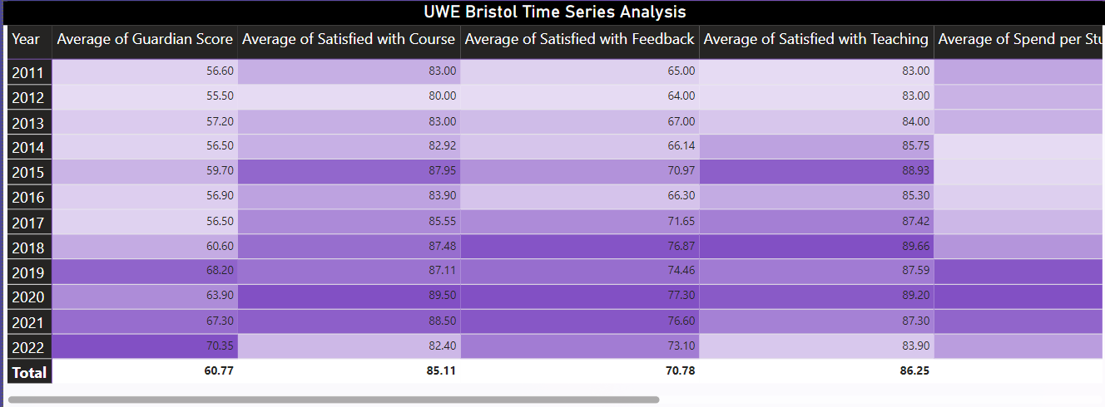
Fig: UWE Bristol Time Series Analysis

Slide 9
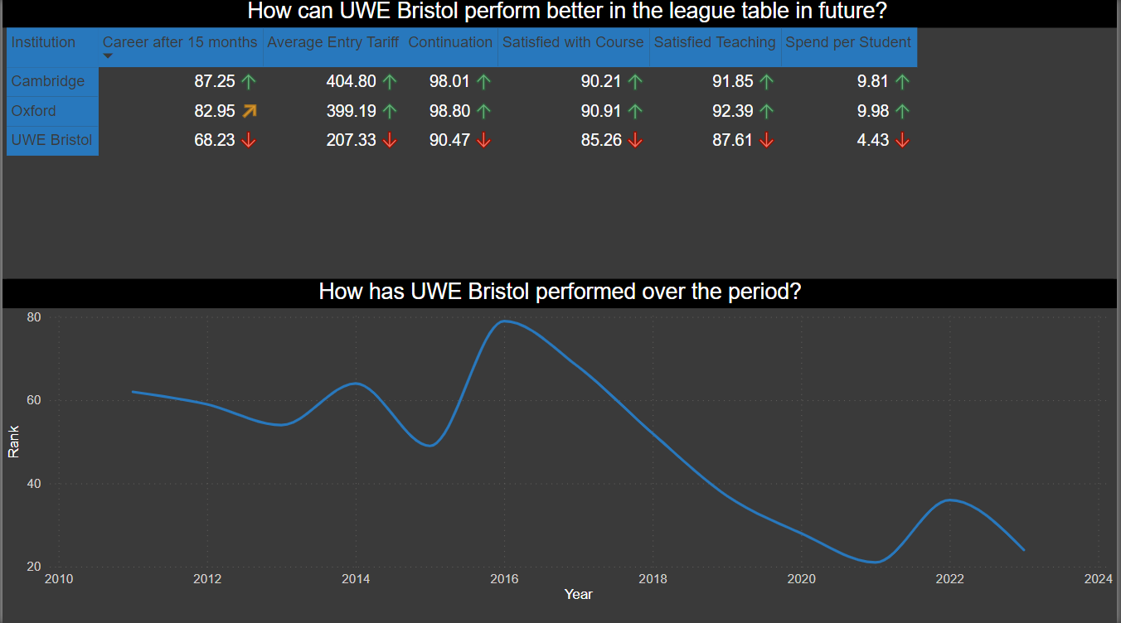
Dashboard 1

Slide 10
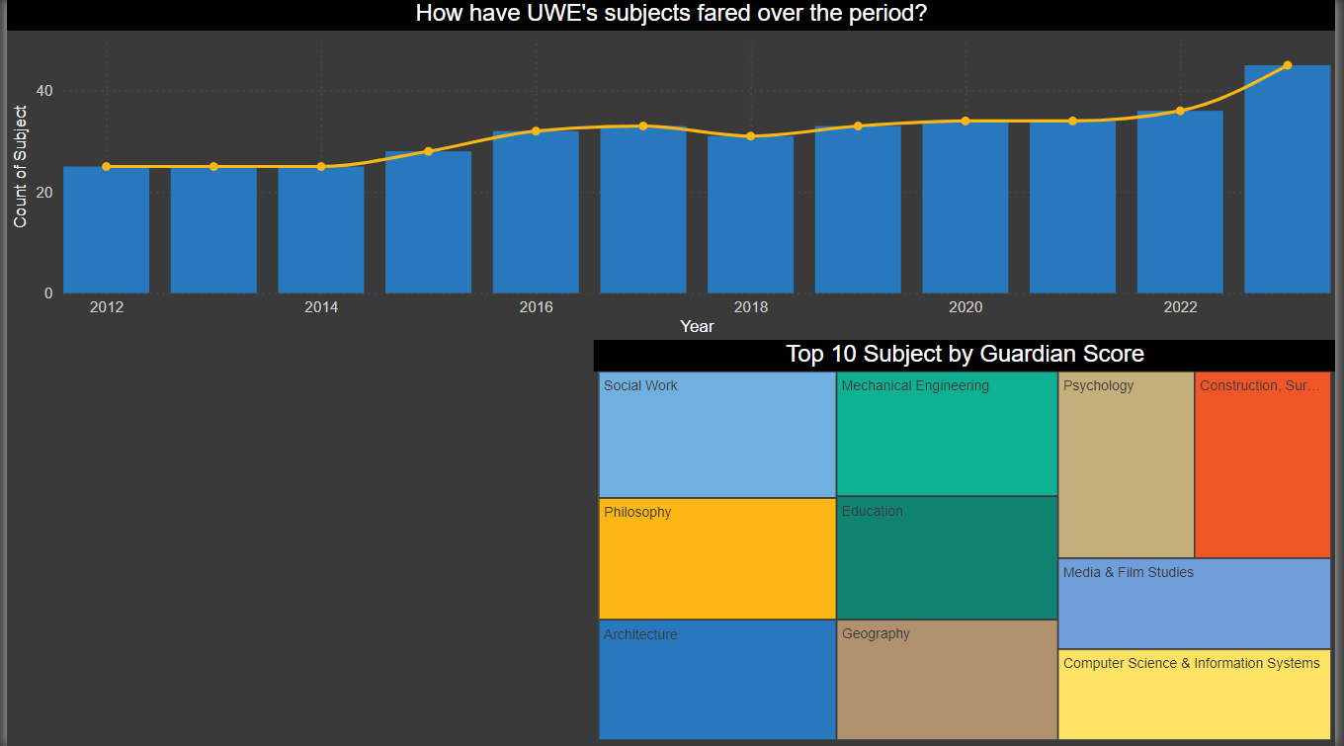
Dashboard 2

Slide 11
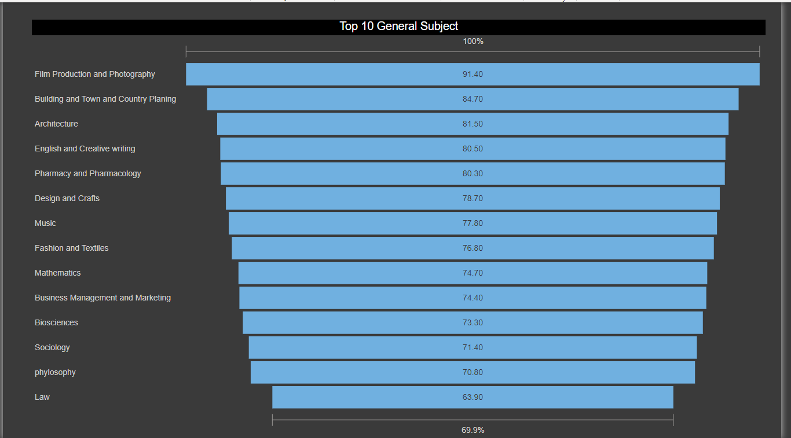
Dashboard 3

Slide 12
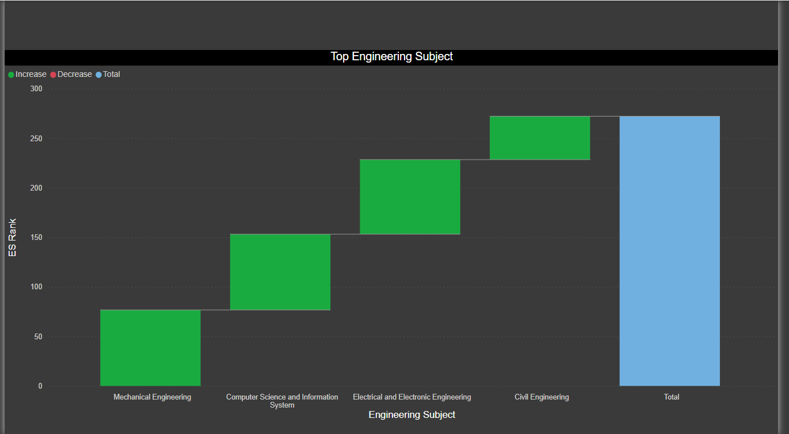
Dashboard 4

Slide 13
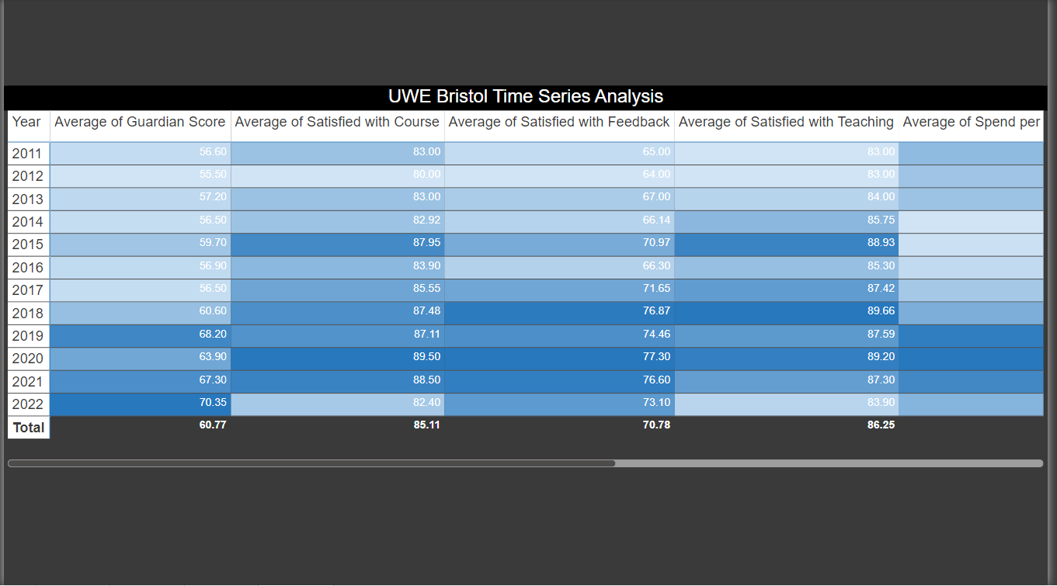
Dashboard 5

Slide 14
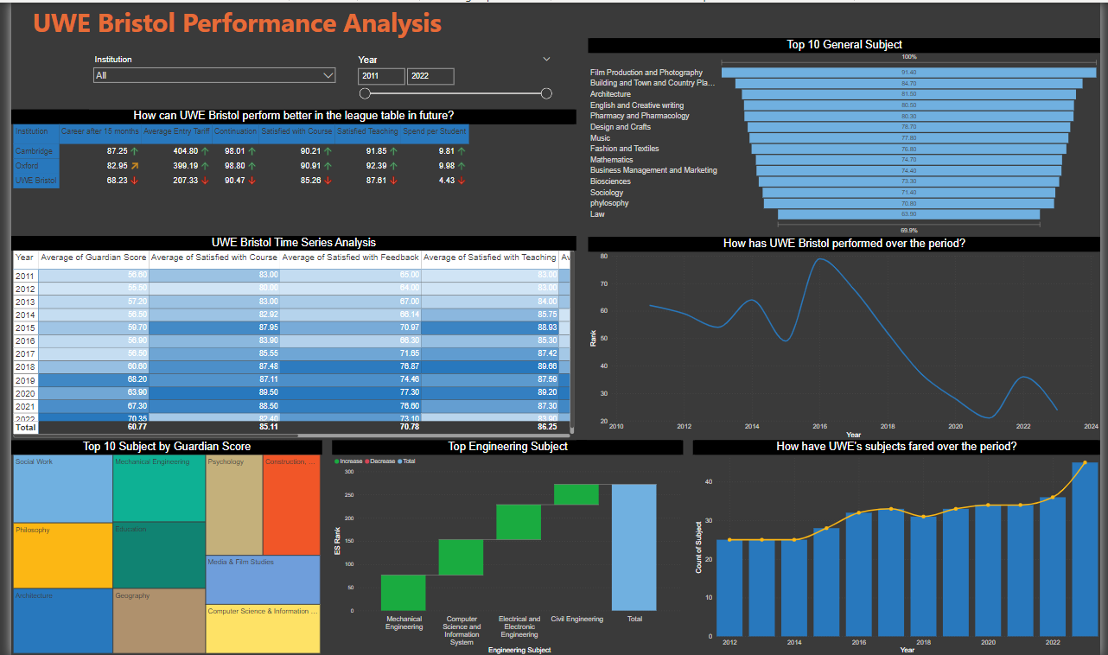
Final Dashboard

